Slide 1
Pattern Dictionary of English Prepositions (PDEP) http://www.clres.com/pdep.html
Ken Litkowski
CL Research
9208 Gue Road
Damascus, Maryland USA
ken@clres.com

Slide 2
PDEP Objectives
A new lexical resource for the study of preposition behavior
An environment for characterizing all English prepositions
A detailed examination of their prototypical syntagmatic patterns
Based on representative corpus instances (47285 sentences from the BNC)
Characterizing the preposition objects (complements) and the point of attachment (governor)
Within a semantic framework of traditional English grammar (Quirk et al., 1985)

Slide 3
PDEP Motivations
Need for a representative corpus of prepositions
Results from SemEval 2007 preposition WSD did not generalize
Decline from 88.4 percent to 39.4 percent accuracy
Results skewed by reliance on FrameNet instances
Value of prepositional phrases in joint modeling with verbs for semantic role labeling
Put prepositions into consistent theoretical lexicographic framework
Follow principles of Hanks theory of norms and exploitations
Interface with Pattern Dictionary of English Verbs (PDEV) with corpus pattern analysis (CPA)

Slide 4
PDEP Design Considerations
Provide an interface to facilitate examination of corpus evidence
Modeled behavior and used code from CPA of PDEV
Integrated tagging of corpus instances with PDEP patterns (senses)
Add capability to examine features of preposition behavior
Expand TPP fields to capture syntactic and semantic features of preposition use
Generate dependency parses for corpus instances (Tratz)
Exploit semantic and syntactic features (including WordNet)
Add other resources (FrameNet and VerbNet)
Add capability for analysis of preposition classes

Slide 5
The Preposition and Pattern Inventories
Preposition inventory
Lists 304 single-word and phrasal prepositions
Number of patterns for each
Number of instances from three corpora (FrameNet, Oxford English Corpus, TPP), with number tagged in TPP
Target size for TPP instances was 250
Pattern list for each preposition
Each sense shows sense number, number of instances in each corpus, syntagmatic pattern, and primary implicature
Pattern details (pattern box)
Syntactic and semantic properties of the complement and the governor (TPP data, feature selectors, ontological categories)
Semantic class, semantic type, cluster (Tratz), and relation (Srikumar)
Syntactic function and meaning (from Quirk)
Substitutable prepositions

Slide 6
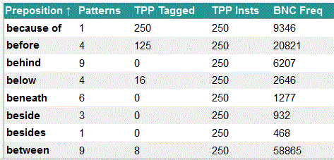
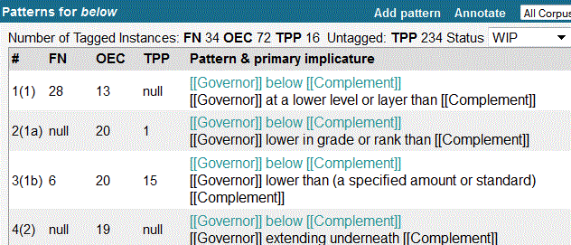
Preposition Inventory (Fragment) Preposition Pattern List (below)

Slide 7
Preposition Pattern Details

Slide 8
Tagging Process
Starts with display of TPP instances (sentences) not yet tagged
Examination of complement and governor features (including WordNet, FrameNet, and VerbNet)
Comparison with existing pattern (sense) inventory
Selecting instances and tagging with a sense
Adding senses as needed
Identifying ill-formed instances
Further analysis of instances with tagged senses to characterize behavior

Slide 9
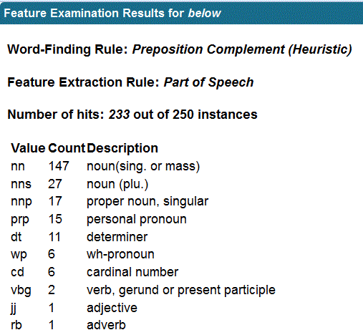
Feature Examination
Word-Finding Rules
Governor (verb or head to the left, head to the left, verb to the left, word to the left, governor)
Complement (syntactic preposition complement, heuristic preposition complement)
Feature Extraction Rules
Word class, part of speech, lemma, word, WN lexical name, WN synonyms, WN hypernyms, whether capitalized, affixes

Slide 10
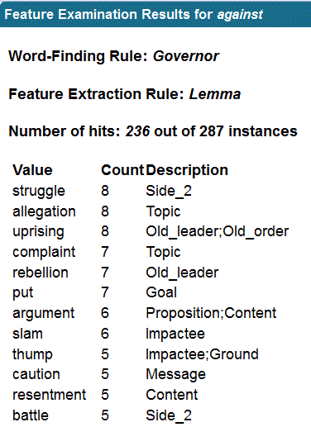
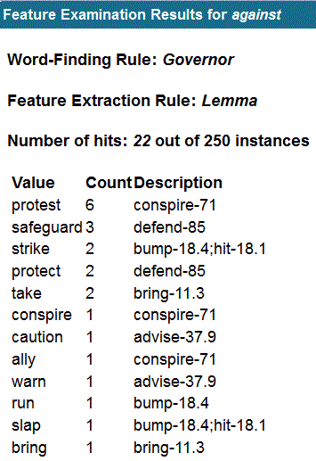
Examining FrameNet Lexical Units and VerbNet Classes

Slide 11
Selecting and Tagging Instances

Slide 12
Preposition Class Analyses
Corpus evidence and tagging provides a check on class assignments (and reveals past inconsistencies)
Substitutable prepositions (Yuret) and collapsing semantically-related senses across prepositions (Srikumar & Roth)
E.g. for temporal class, 21 senses of 14 prepositions in Srikumar and 62 senses in 50 prepositions in PDEP
Quirk paragraphs provide organizing principle
PDEP enables bottom-up approach, building details for an individual sense
Proceeds by organizing nuances across prepositions
Generalizes complement and governor behavior for class
Provides basis for enhanced cross-preposition analysis

Slide 13
Future Developments
Completion of tagging (now at 23%)
Identifying complement and governor in sentence display
Additional download options
Access to PHP scripts
Download of full, up-to-date data sets
Collocation analysis
Processing of instances with USAS tagger (UCREL semantic analysis system

Slide 14
Evaluation of Preposition Data
Essential to drive future developments on utility of PDEP data
All 81509 sentences available in SemEval lexical sample format
PDEP data available in online Javascript Object Notation (JSON)
Use of data in SemEval tasks (TempEval, SpaceEval, CauseEval?)
Potential SemEval 2016 task on dictionary entry building (modeled on SemEval 2015 CPA task)

Slide 15
NLP Community Involvement
Volunteers to help tagging and preposition characterization
What do you want?
Suggestions for incorporation of additional resources
Critiques of existing structures
Suggestions for further analyses

Slide 16
Summary and Conclusions
The Pattern Dictionary of English Prepositions (PDEP) is a new lexical resource for the study of preposition behavior
Provides 81509 sentences, 47285 as a representative sample
All sentences dependency-parsed, with features to describe preposition behavior
PDEP has been designed to explore and download any of the available data

